Slide 1

BARKATULLAH UNIVERSITY INSTITUTE OF TECHNOLOGY
MINOR PROJECT ON
COMMENT CLASSIFIER
Submitted By:
Vinayak Modi
Ankit Patil
Submitted To:
Mr. Bhawani Singh Rathore
Mrs. Kavita Chourasia

Slide 2

COMMENT CLASSIFIER

Slide 3

CONTENT
Introduction to project
Project Description
Result
Advantages and Disadvantages
Future Scope
Conclusion

Slide 4

Introduction to comment classifier
Comment Classifier is machine learning model that classifies comments according different classes such as Absuive, Offfensive, or not both of them. Importance of comment classification in various applications (e.g., social media, customer feedback analysis)

Slide 5
Project data flow
To illustrate the data flow of a comment classifier:
DATA PREPARATION
DATA PREPROCESSING
FEATURE EXTRACTION
TRAINING DATASET SPLIT
MODEL TRAINING
COMMENT CLASSIFICATION

Slide 6

Languages and Libraries Used:
Python: The Python interpreter and the extensive standard library are available in source or binary form without charge for all major platforms, and can be freely distributed. Python is the primary programming language used for the comment classifier.
Key use of python in project:-
Data Manipulation
Data Preprocessing
Machine Learning
Gradio Interface

Slide 7

PYTHON LIBRARIES USED:
• gradio: Used for creating the user interface to interact with the comment classifier.
• pandas: Used for data manipulation and analysis, particularly for loading and handling the dataset.
• numpy: Used for numerical operations and array manipulation.
• sklearn.feature_extraction.text.CountVectorizer: Used for converting text data into numerical features.
• sklearn.model_selection.train_test_split: Used for splitting the dataset into training and testing sets.
• sklearn.tree.DecisionTreeClassifier: Used for training the decision tree classifier.
• re: Used for regular expression operations, specifically for cleaning the comment text.
• nltk: Used for natural language processing tasks, such as downloading stopwords and stemming.
• nltk.corpus.stopwords: Used for obtaining a set of common stopwords.
• `string`: Used for working with string operations and punctuation removal.

Slide 8
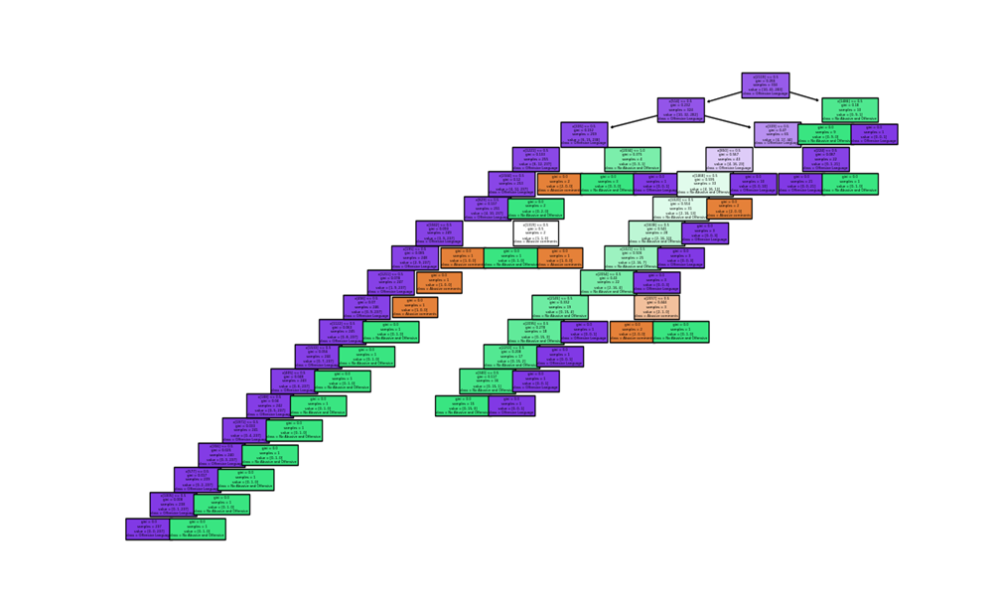
Decision Tree:
A Decision Tree is a flowchart-like representation of data that graphically resembles a tree that has been drawn upside down.
In the code for the Comment Classifier, a decision tree algorithm is used as the machine learning model for classification
Decision Tree

Slide 9
NLP
Natural Language Processing (NLP) techniques are used in the provided code for the comment classifier. It provide below the use of NLP in the Comment Classifier:
Text Cleaning
Tokenization
Feature Extraction
Stop word Removal
Word Stemming

Slide 10

Pandas
The pandas library is used in the comment classifier code for various data manipulation tasks.
Pandas simplifies the data handling, cleaning, manipulation, and transformation tasks in the comment classifier code. It provides powerful data structures and functions that enable efficient data preprocessing and preparation for machine learning tasks.

Slide 11

Numpy
The NumPy library is used in the comment classifier code to handle numerical operations and array manipulations efficiently.

Slide 12
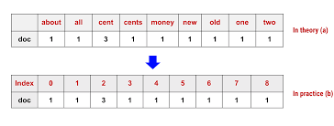
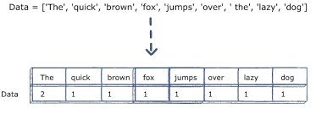
CountVectorizer
The CountVectorizer is a class from the scikit-learn library that is used in the comment classifier code to convert the comment text into numerical feature vectors.

Slide 13

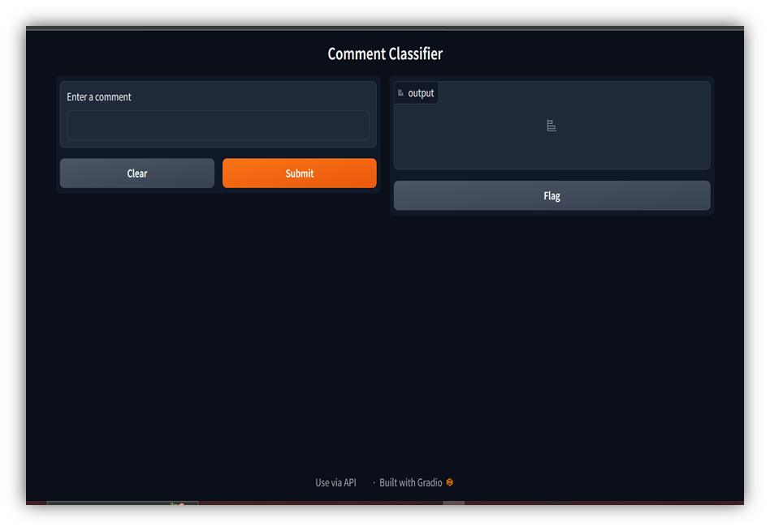
Gradio(GUI)
Gradio is a Python library that provides a simple and intuitive interface for building and deploying interactive web-based interfaces for machine learning models. In the comment classifier code, Gradio is used to create the user interface for interacting with the trained classifier.

Slide 14
Advantages
Comment classifiers offer several advantages in various applications:
Efficiency
Real-time Analysis
Scalability & Consistency
User Experience Improvement
Content Moderation
Time Savings

Slide 15
Disadvantages
While comment classifiers offer several advantages, they also have some limitations and potential disadvantages:
Privacy Concerns
Subjectivity and Contextual Understanding
Lack of Human Judgment
Bias and Fairness

Slide 16
Future Scope
The future scope of comment classifiers is promising, with several potential advancements and applications on the horizon. There are various development can be made in coming future as there contextual understanding, multilingual and cross cultural analysis, enhanced filtering and moderation, integration with chatbots, privacy and data protection.

Slide 17

Conclusion
The Comment Classifier project presents a comprehensive solution for categorizing text comments using machine learning techniques. By automating the classification process, it streamlines content management tasks and enables more efficient analysis of user-generated comments.
It utilizes a decision tree algorithm and natural language processing techniques to effectively classify comments into different categories, such as offensive language, abusive comments, or non-abusive and non-offensive comments.

Slide 18
Q&A

Slide 19

THANK YOU

